Slide 1



NAACL 2025
Beyond the Next Token: Towards
Prompt-Robust Zero-Shot Classification
via Efficient Multi-Token Prediction
Qian Junlang
30 March 2025
Junlang Qian, Zixiao Zhu, Hanzhang Zhou, Zijian Feng, Zepeng Zhai, Kezhi Mao
Notes:
Welcome to School of EEE’s Sharing Session on Laboratory and Safety Matters

Slide 2


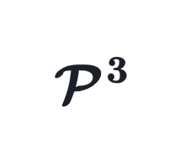
NAACL 2025
Beyond the Next Token: Towards
Prompt-Robust Zero-Shot Classification
via Efficient Multi-Token Prediction
1
Introduction: Background & Our Hypothesis
2
Methodology: Challenge &
3
Experiment & Result Analysis
4
Conclusion
Notes:
Welcome to School of EEE’s Sharing Session on Laboratory and Safety Matters

Slide 3
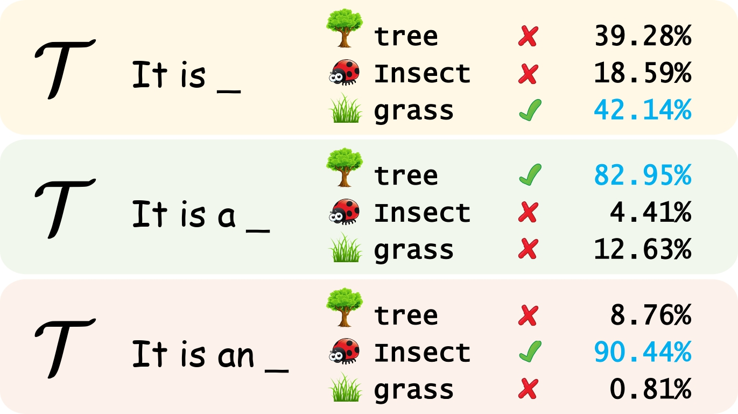
Background: Prompt Brittleness
Zero-shot text classification is among the most challenging applications of pre-trained language models, as it aims to categorize text without additional data
However, outputs of language models are highly sensitive to minor modifications in prompt wording or format, leading to inconsistent performance
Reference:
Quantifying Language Models' Sensitivity to Spurious Features in Prompt Design (Melanie Sclar et al.)
Why Johnny Can’t Prompt (J.D. Zamfirescu-Pereira et al.)

Slide 4
Beyond the Next Token: Towards Prompt-Robust Zero-Shot Classification via Efficient Multi-Token Prediction
good
bad
Observation:
Language model
Current methods predominantly rely on next-token prediction to classify.
<start>
Quantum
computing
is
the
future
Intuitions:
.
It
is
Since the next token directly follows the input, it would be inevitably impacted by the prompt, whereas later tokens are likely less sensitive;
Language models may not immediately provide the answer as the next token. Instead, they often first generate non-discriminative words such as “so”, “a”, or “very”, or engage in preliminary reasoning, which could hurt next-token performance for certain prompts.
Input: Output: | My ACL paper is accepted. It is _ a very good paper.
Input: Output: | My legs are broken. I am _ in a lot of pain.
Input: Output: | I had my first job this year. It is _ a part-time job at a local restaurant. I am a waitress. I like my job very much.

Slide 5
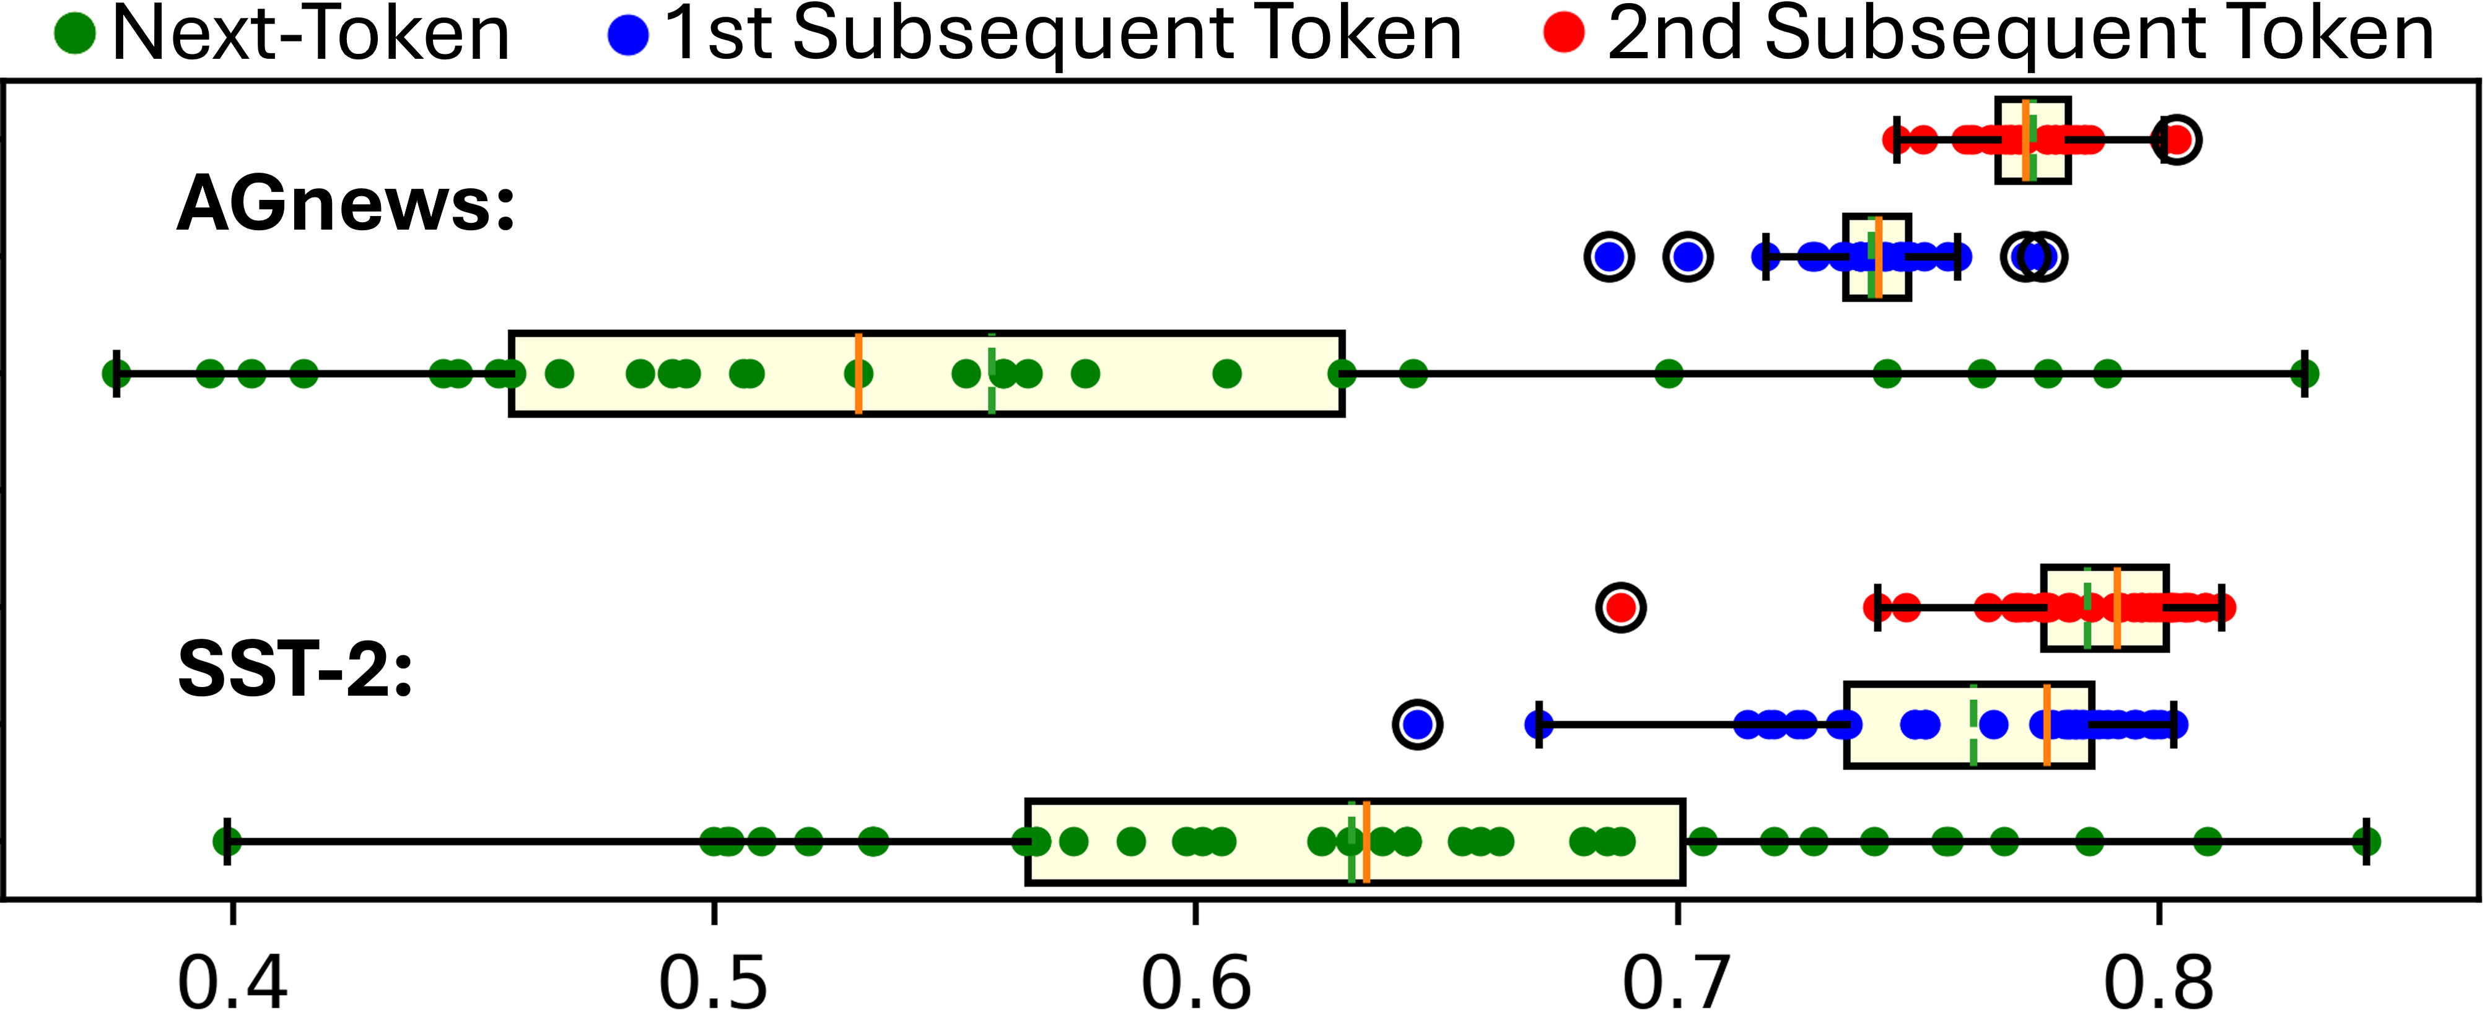
Beyond the Next Token: Towards Prompt-Robust Zero-Shot Classification via Efficient Multi-Token Prediction
Hypothesis:
The sole reliance on the next token may contribute to prompt brittleness.
Some Evidence:

Slide 6
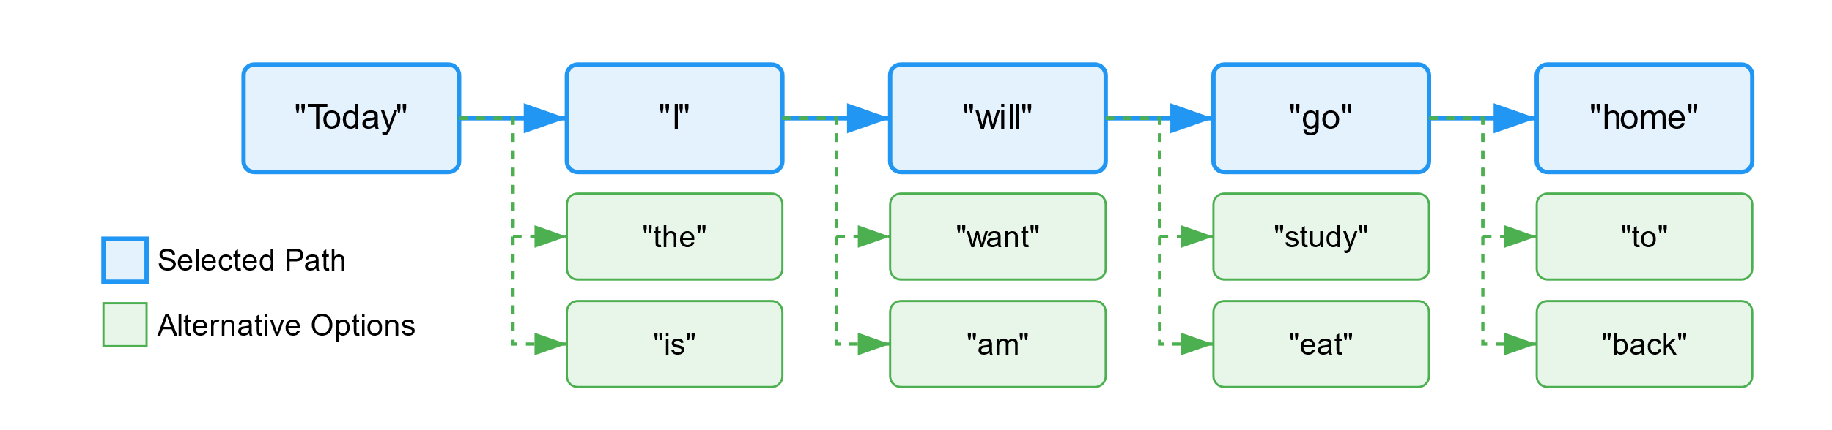
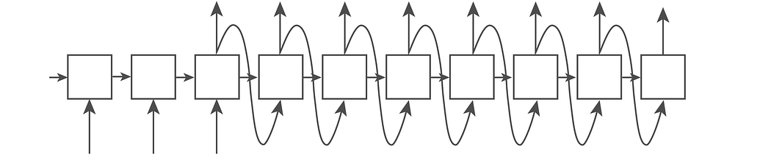
Challenge: only one token out
Current auto-regressive language models predict only the next token.
To generate multiple tokens, the model run repeatedly for each token.
Note:
Exceptions exist: Some language models like DeepSeek-V3 can predict up to four tokens but is still insufficient for our needs (more than ten tokens). Therefore, these models are not included in our study.

Slide 7
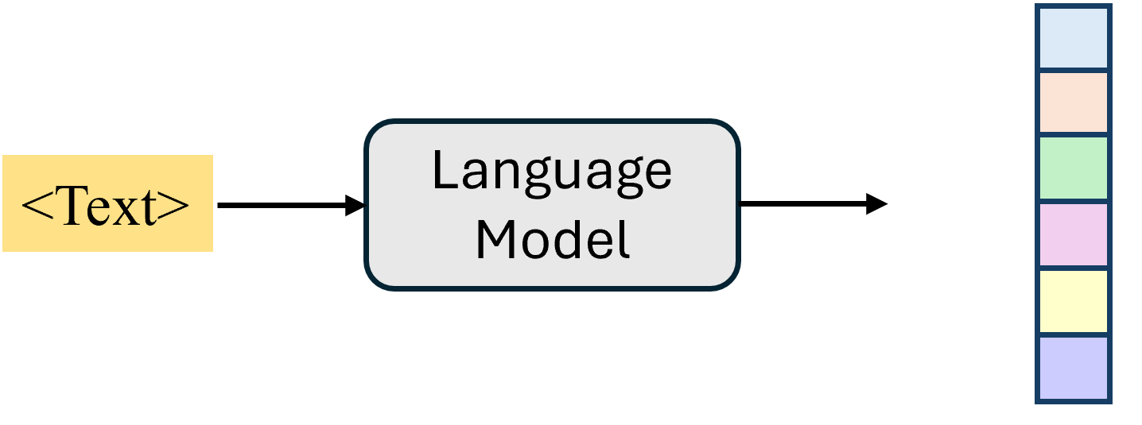
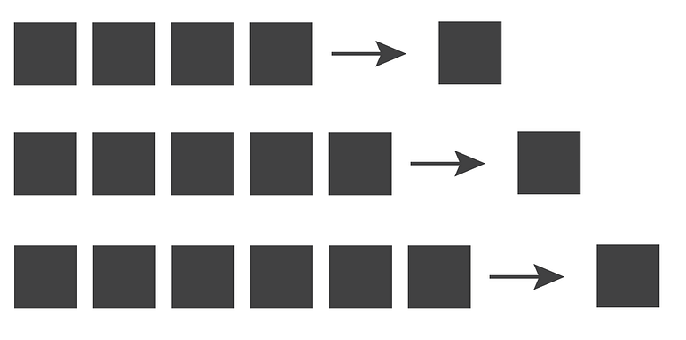
Challenge: only one token out
When considering all possible generation probabilities (token generation probability distribution), only the next token can be utilized.
When considering multiple tokens, only information from one generation path can be utilized.
Moreover, this approach is inefficient.
prompt brittleness
path randomness

Slide 8
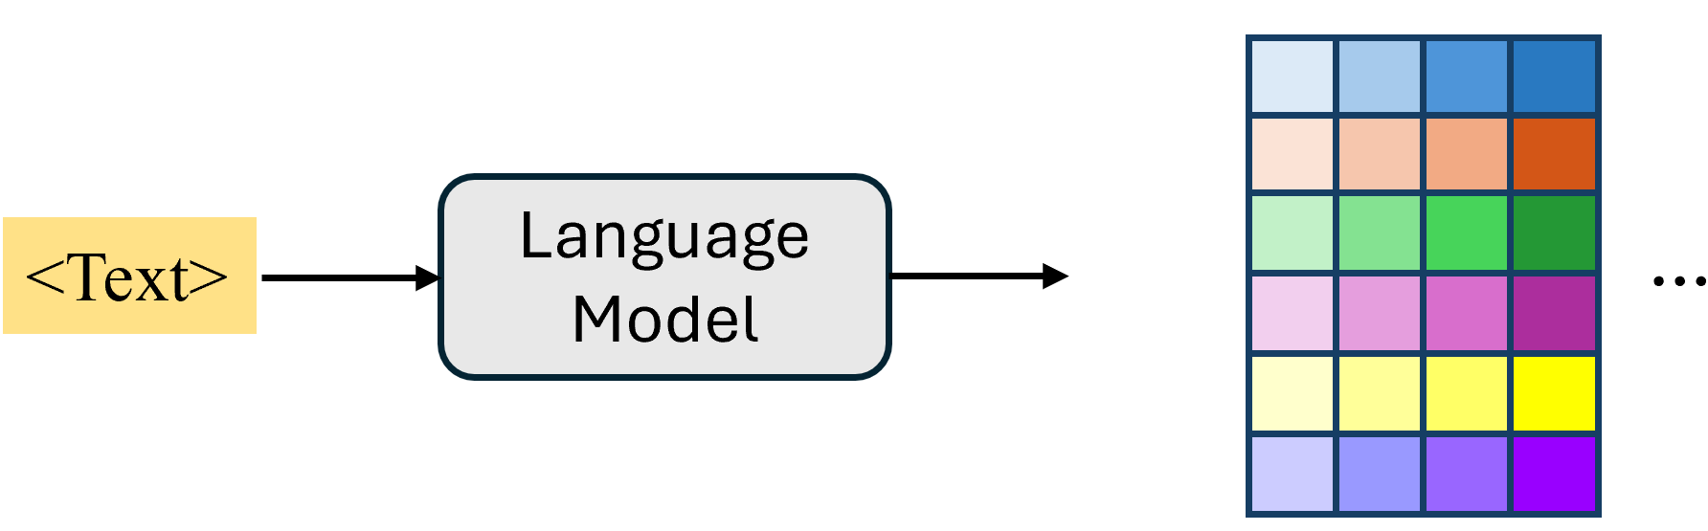
Beyond the Next Token: Towards Prompt-Robust Zero-Shot Classification via Efficient Multi-Token Prediction
Methodology:
Can we utilize the entire token probability distribution across multiple positions simultaneously to enhance robustness?

Slide 9
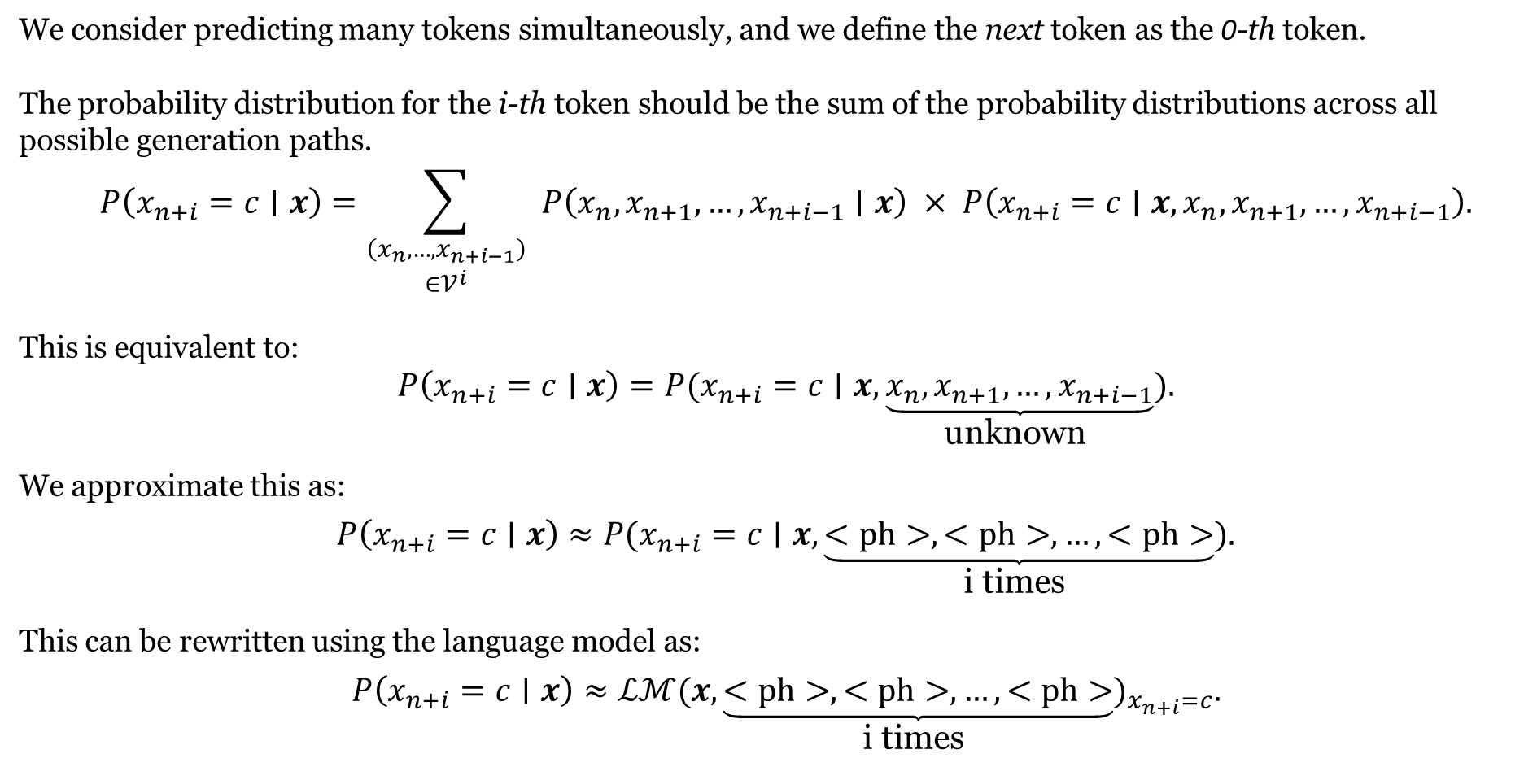
Beyond the Next Token: Towards Prompt-Robust Zero-Shot Classification via Efficient Multi-Token Prediction
We consider predicting many tokens simultaneously, and we define the next token as the 0-th token.
The probability distribution for the i-th token should be the sum of the probability distributions across all possible generation paths.
$$\begin{matrix} & P\left(x_{n+i}=c∣x\right)=\sum_{\begin{matrix}\left(x_{n},…,x_{n+i−1}\right) \\ ∈𝒱^{i}\end{matrix}}{ } P\left(x_{n},x_{n+1},…,x_{n+i−1}∣x\right) × P\left(x_{n+i}=c∣x,x_{n},x_{n+1},…,x_{n+i−1}\right).\end{matrix}$$
This is equivalent to:
$$\begin{matrix} & P\left(x_{n+i}=c∣x\right)=P(x_{n+i}=c∣x,\underset{\text{unknown} }{\underbrace{x_{n},x_{n+1},…,x_{n+i−1}}}).\end{matrix}$$
We approximate this as:
$$\begin{matrix} & P\left(x_{n+i}=c∣x\right)≈P(x_{n+i}=c∣x,\underset{\text{i} \text{times} }{\underbrace{<ph>,<ph>,…,<ph>}}).\end{matrix}$$
This can be rewritten using the language model as:
$$\begin{matrix} & P\left(x_{n+i}=c∣x\right)≈ℒℳ(x,\underset{\text{i} \text{times} }{\underbrace{<ph>,<ph>,…,<ph>}})_{x_{n+i}=c}.\end{matrix}$$

Slide 10
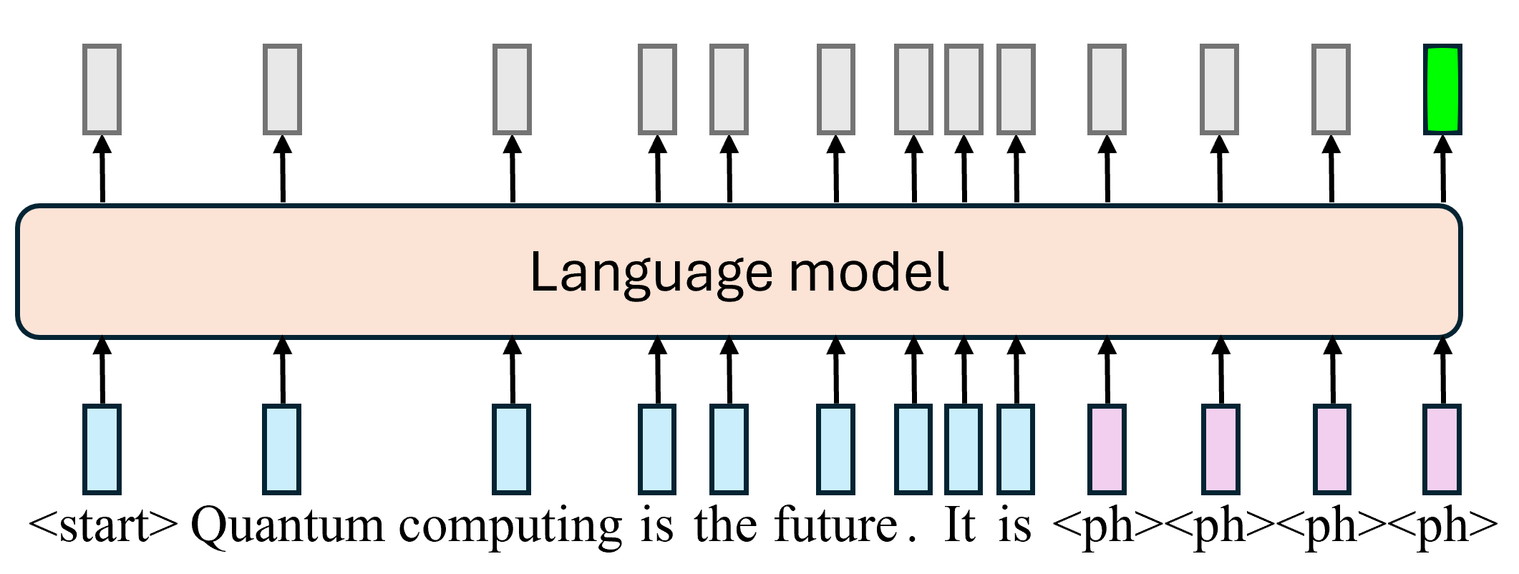
Beyond the Next Token: Towards Prompt-Robust Zero-Shot Classification via Efficient Multi-Token Prediction
Placeholding Skipping Prediction (PSP)

Slide 11
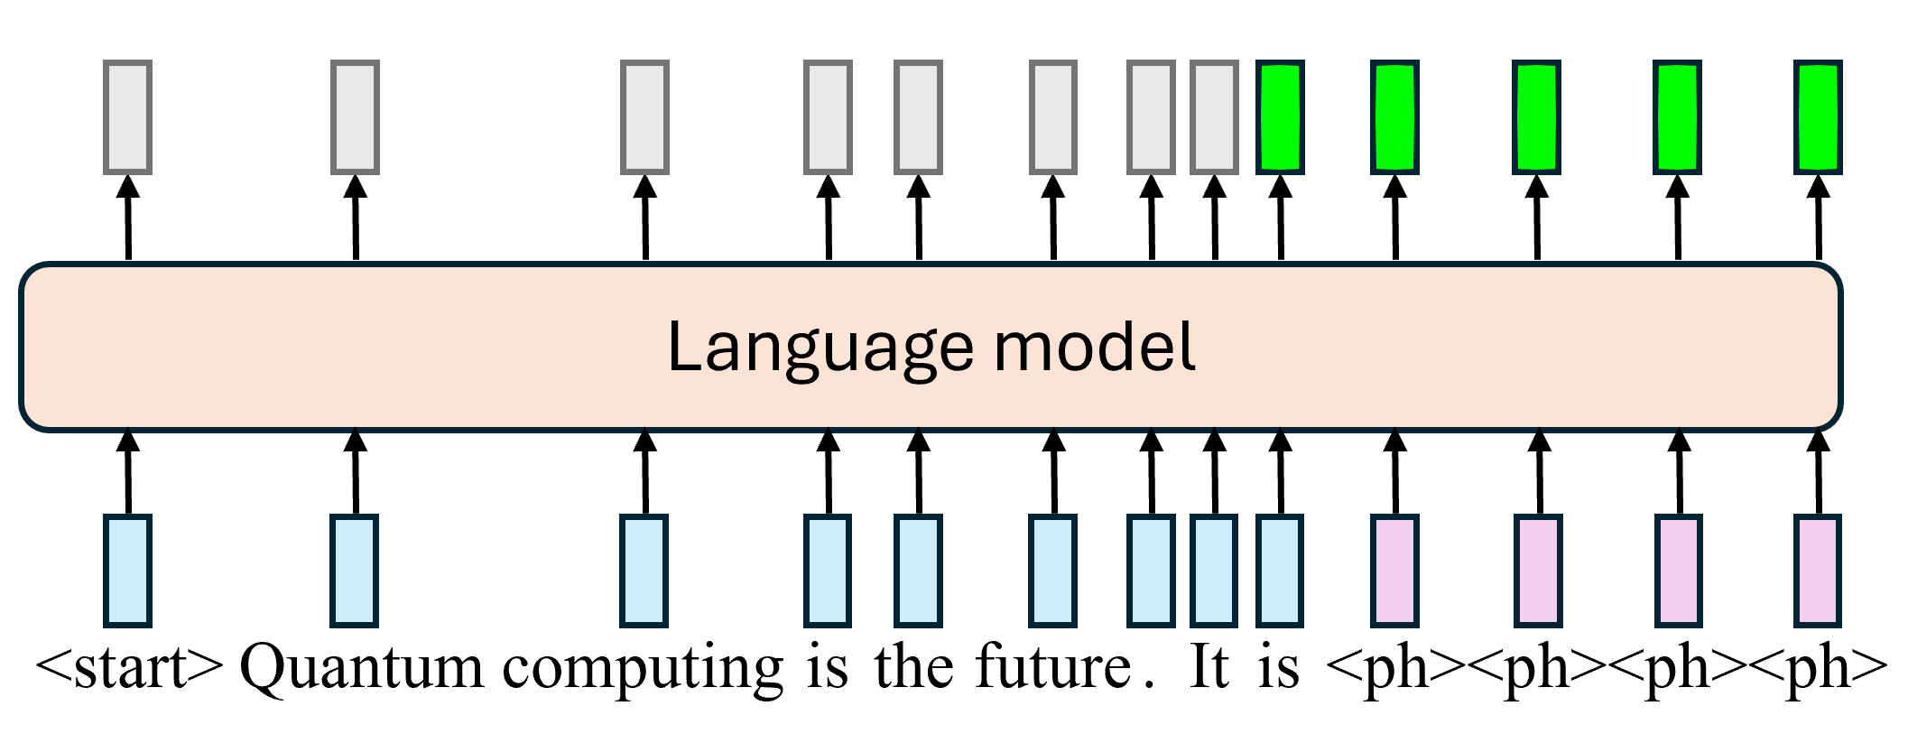
Beyond the Next Token: Towards Prompt-Robust Zero-Shot Classification via Efficient Multi-Token Prediction
Placeholding Parallel Prediction
( )

Slide 12
Beyond the Next Token: Towards Prompt-Robust Zero-Shot Classification via Efficient Multi-Token Prediction
Experiment:
Two language models:
LLaMA2-13b
LLaMA2-70b
Seven datasets:
Amazon Review Polarity, SST2, IMDb, AG news,
Yahoo Answers, Dbpedia, ISEAR
30+ plausible prompts for each dataset

Slide 13
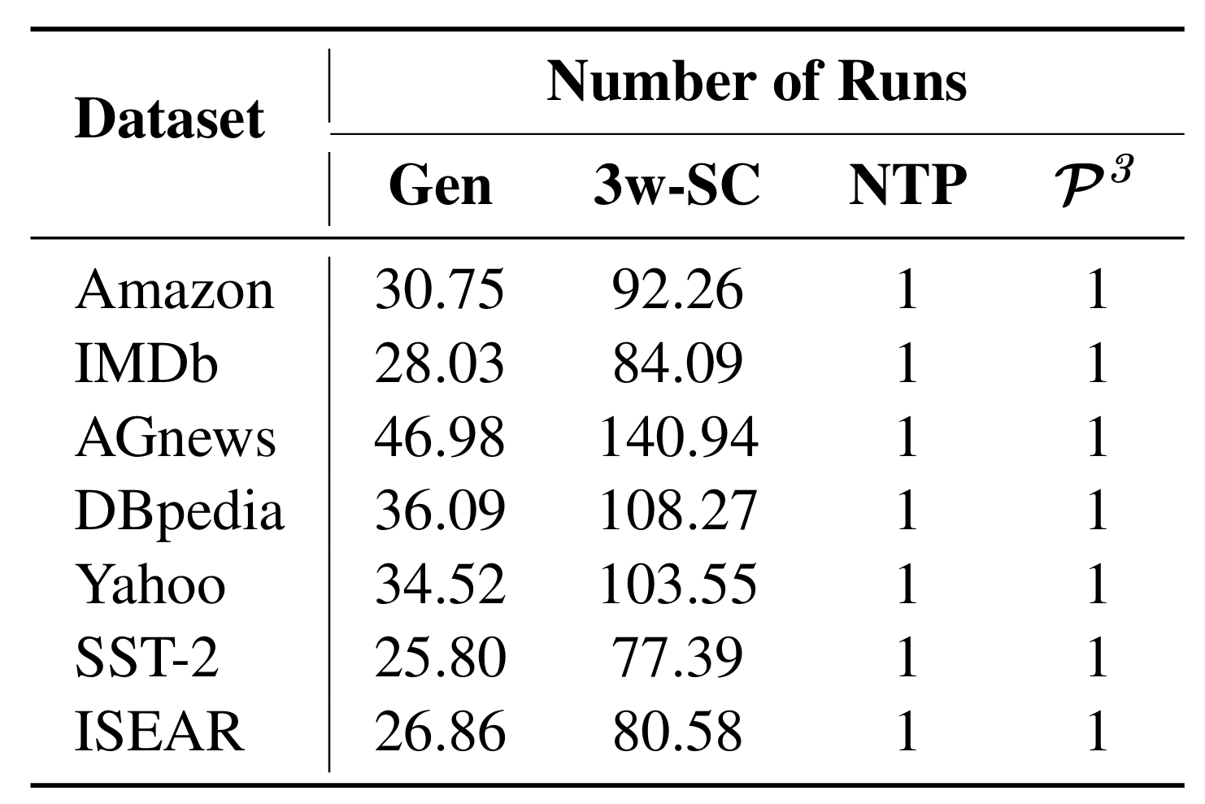
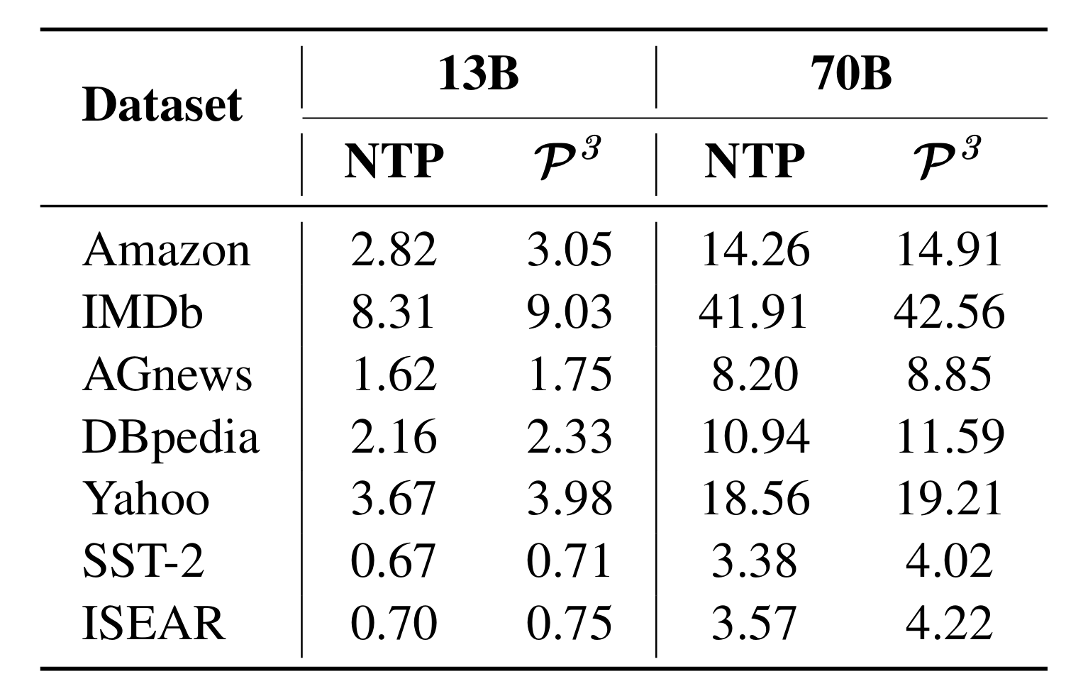
Beyond the Next Token: Towards Prompt-Robust Zero-Shot Classification via Efficient Multi-Token Prediction
Result: Efficiency
The average number of output tokens used to reach an answer (number of model runs).
T Flops

Slide 14
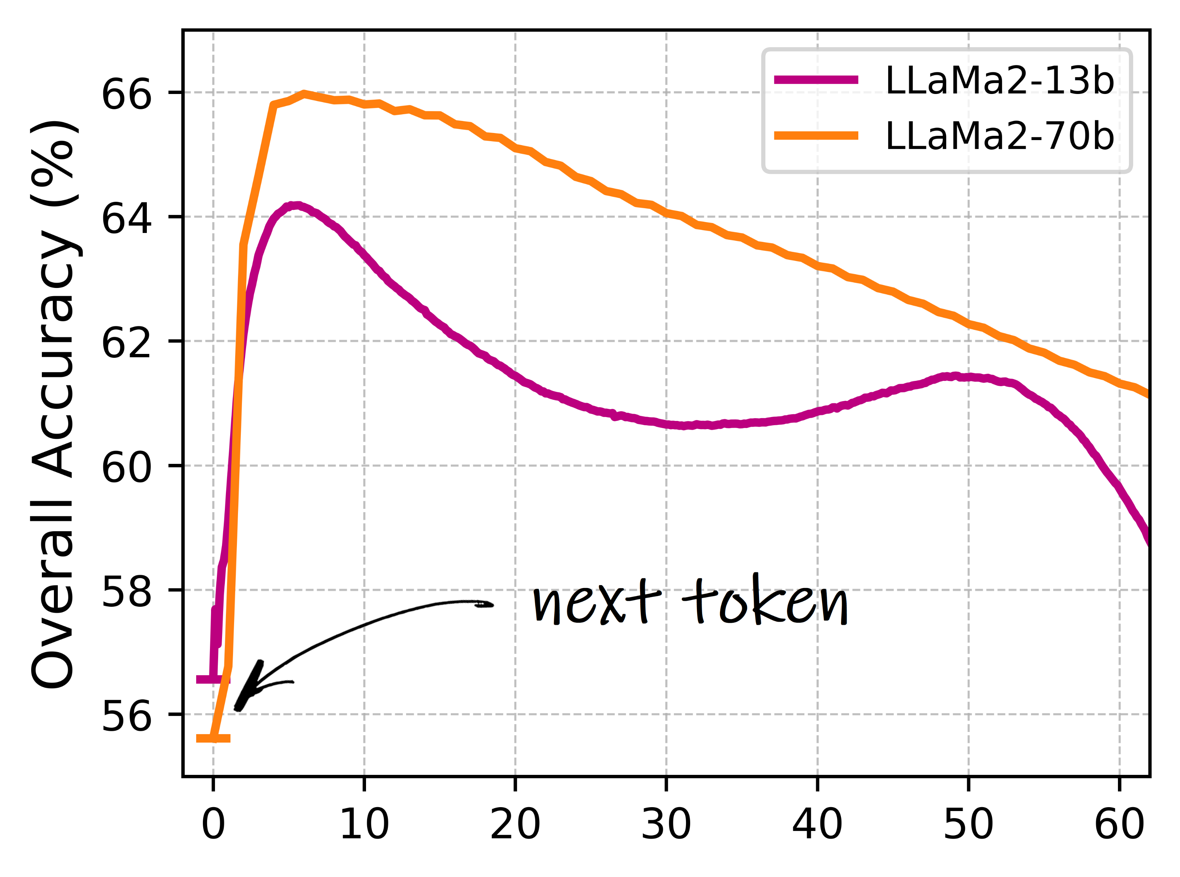
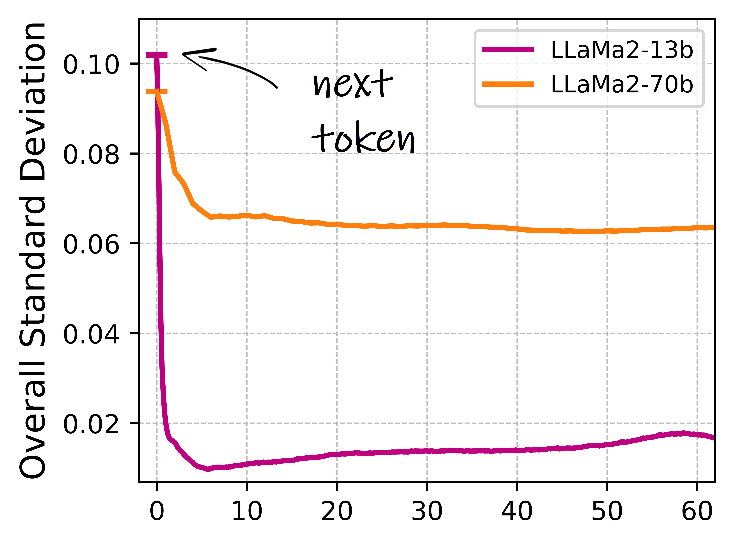
Beyond the Next Token: Towards Prompt-Robust Zero-Shot Classification via Efficient Multi-Token Prediction
Result: Robustness & Accuracy

Slide 15
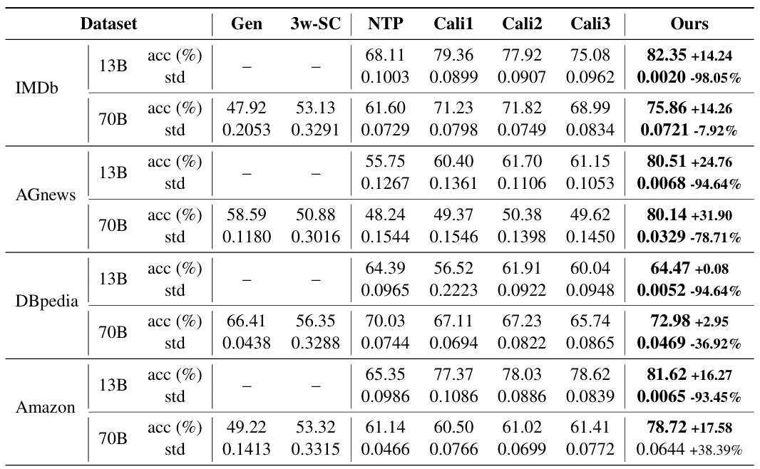
Beyond the Next Token: Towards Prompt-Robust Zero-Shot Classification via Efficient Multi-Token Prediction
Result: Robustness & Accuracy

Slide 16
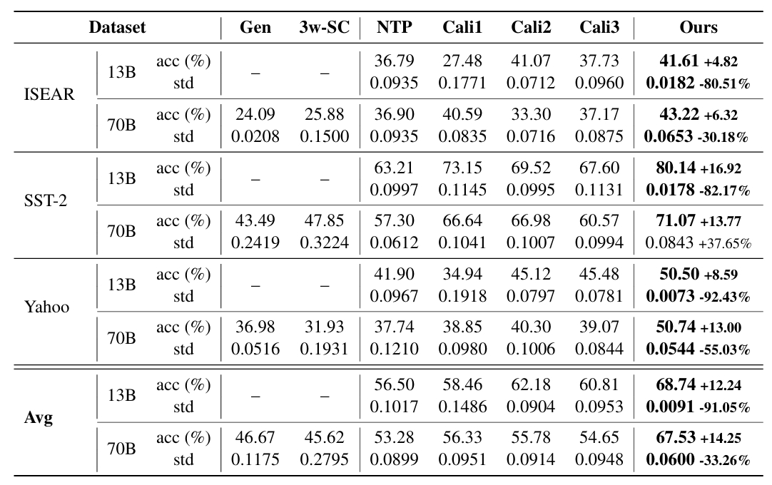
Beyond the Next Token: Towards Prompt-Robust Zero-Shot Classification via Efficient Multi-Token Prediction
Result: Robustness & Accuracy

Slide 17
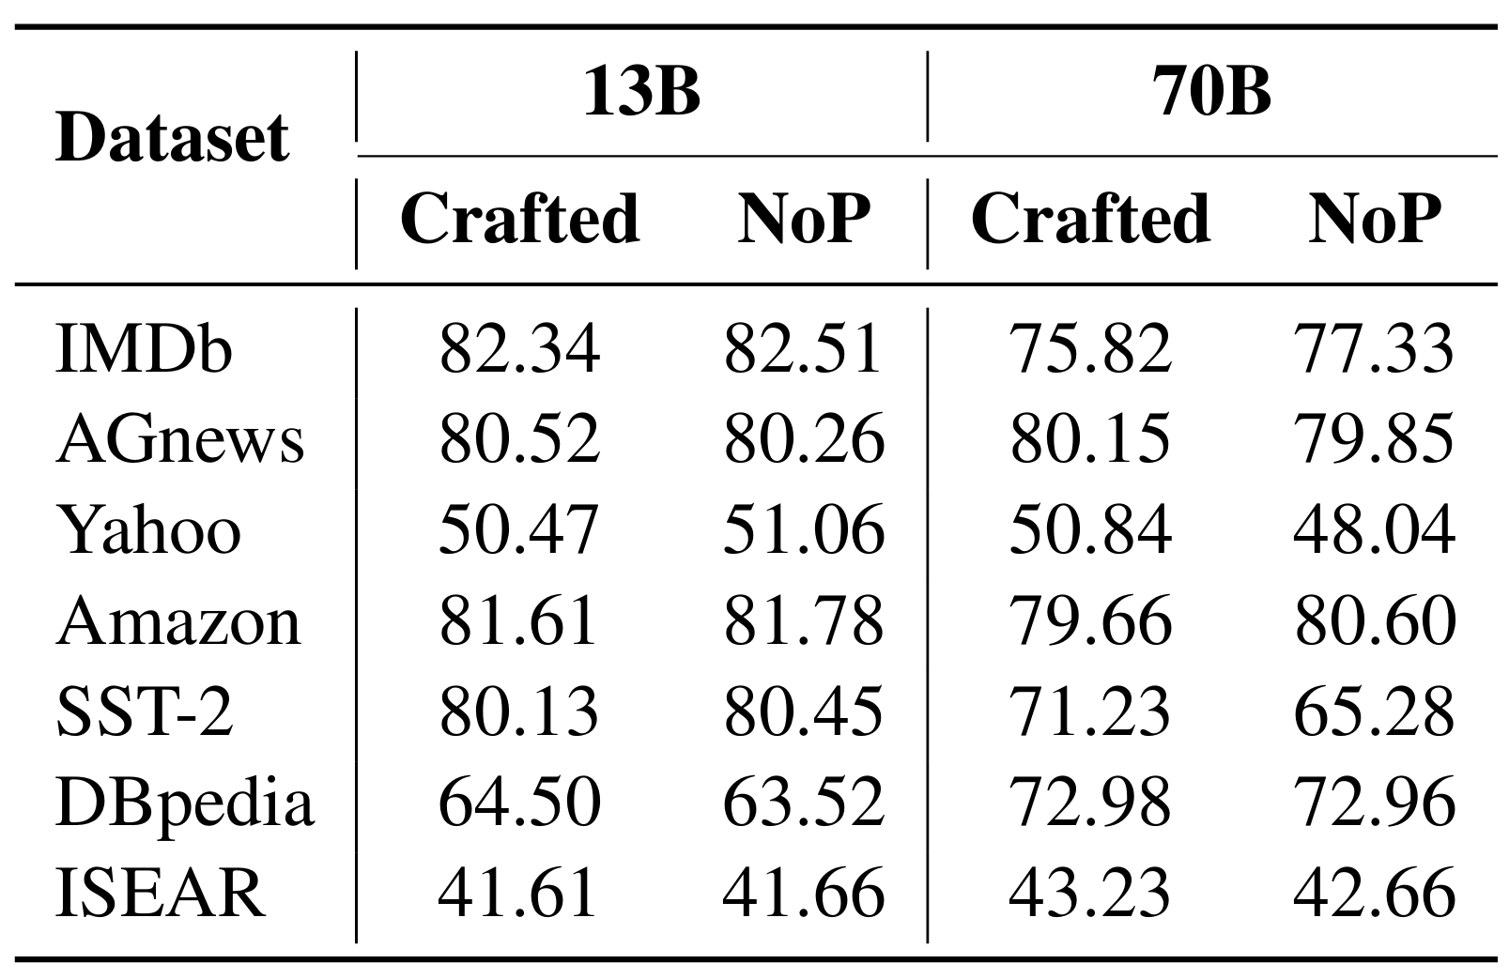
Beyond the Next Token: Towards Prompt-Robust Zero-Shot Classification via Efficient Multi-Token Prediction
Result: Performance w/wo Prompt
w/ w/o
w/ w/o

Slide 18
Beyond the Next Token: Towards Prompt-Robust Zero-Shot Classification via Efficient Multi-Token Prediction
Conclusion:
can generate multiple subsequent token predictions in a single run.
A narrow focus on next-token prediction may contribute to prompt brittleness. Considering more tokens can enhance robustness and achieve higher accuracy.
performs comparably with and without prompts, reducing reliance on prompt engineering.

Slide 19
30 March 2025
Beyond the Next Token: Towards
Prompt-Robust Zero-Shot Classification
via Efficient Multi-Token Prediction
Thank you!
Qian Junlang
junlang001@e.ntu.edu.sg
Notes:
Welcome to School of EEE’s Sharing Session on Laboratory and Safety Matters

